Slide 1

Bootstrap

Slide 2
Prerequisites
Basic idea about web development
Knowledge about HTML
Basic and Advanced concept/idea of CSS.

Slide 3
Learning Objectives
Bootstrap Introduction
What You Can Do with Bootstrap
Usage of Bootstrap
Download
Bootstrap Responsive Layout
Create bootstrap Project

Slide 4
What is Bootstrap
Bootstrap is the most popular and powerful front-end (HTML, CSS, and JavaScript) framework for faster and easier responsive web development.
It is absolutely free to download and use.
It facilitates you to create responsive designs.

Slide 5
Advantages of Using Bootstrap
Easy to use: Anybody with just basic knowledge of HTML and CSS can start using Bootstrap
Responsive features: Bootstrap's responsive CSS adjusts to phones, tablets, and desktops
Mobile-first approach: In Bootstrap, mobile-first styles are part of the core framework
Browser compatibility: Bootstrap 5 is compatible with all modern browsers

Slide 6
What You Can Do with Bootstrap
Easily create responsive websites.
Quickly create multi-column layout with pre-defined classes.
Quickly create different types of form layouts.
Quickly create different variation of navigation bar.
Easily create tooltips and popovers to show hint text.
Easily create carousel or image slider to showcase your content.

Slide 7
Download Bootstrap
Include Bootstrap 5 from a CDN(Content Delivery Network)
Download Bootstrap 5 from getbootstrap.com
Installation with npm(Node Package Manager)

Slide 8
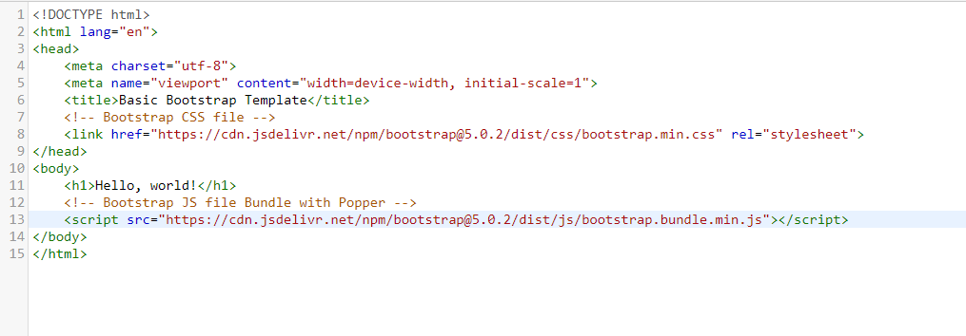
CDN

Slide 9
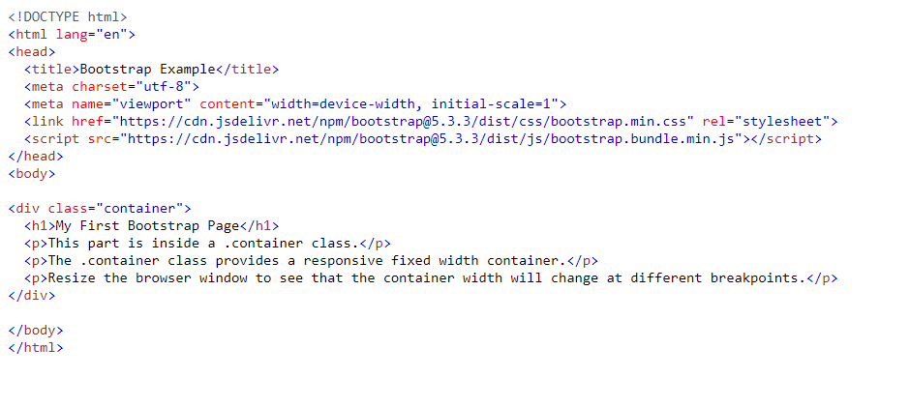

Slide 10
One advantage of using the Bootstrap 5 CDN
Many users already have downloaded Bootstrap 5 from jsDelivr when visiting another site. As a result, it will be loaded from cache when they visit your site, which leads to faster loading time. Also, most CDN's will make sure that once a user requests a file from it, it will be served from the server closest to them, which also leads to faster loading time.

Slide 11
Downloading the Bootstrap Files
Download the Bootstrap's CSS and JS files from their official website and include in your project.
https://github.com/twbs/bootstrap/archive/v5.0.2.zip

Slide 12
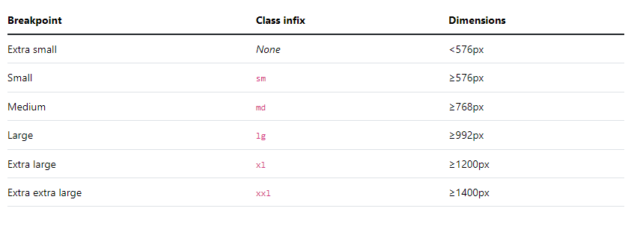
Responsive Layout
Breakpoints are customizable widths that determine how your responsive layout behaves across device or viewport sizes in Bootstrap.

Slide 13
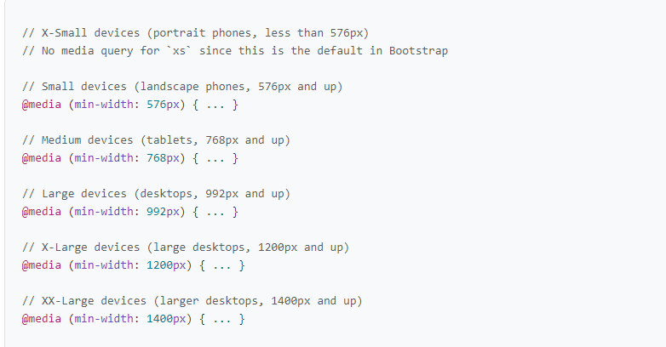
Media queries-Min width

Slide 14
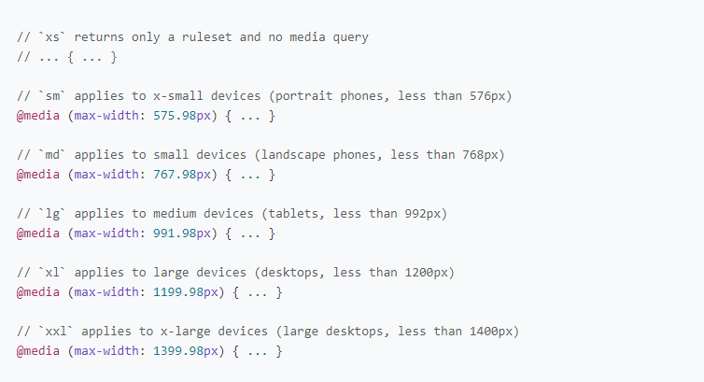
Media queries-Max width

Slide 15
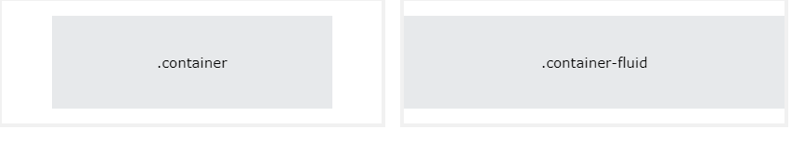
Containers
Containers are a fundamental building block of Bootstrap that contain, pad, and align your content within a given device or viewport.

Slide 16
Containers
Container → Provides a responsive fixed width container
Container-fluid → Provides a full width container, spanning the entire width of the viewport

Slide 17

Thank You!

